Slide 1
Amazon Product Page Review
Week 3 Assignment- Hritika Kucheriya

Slide 2
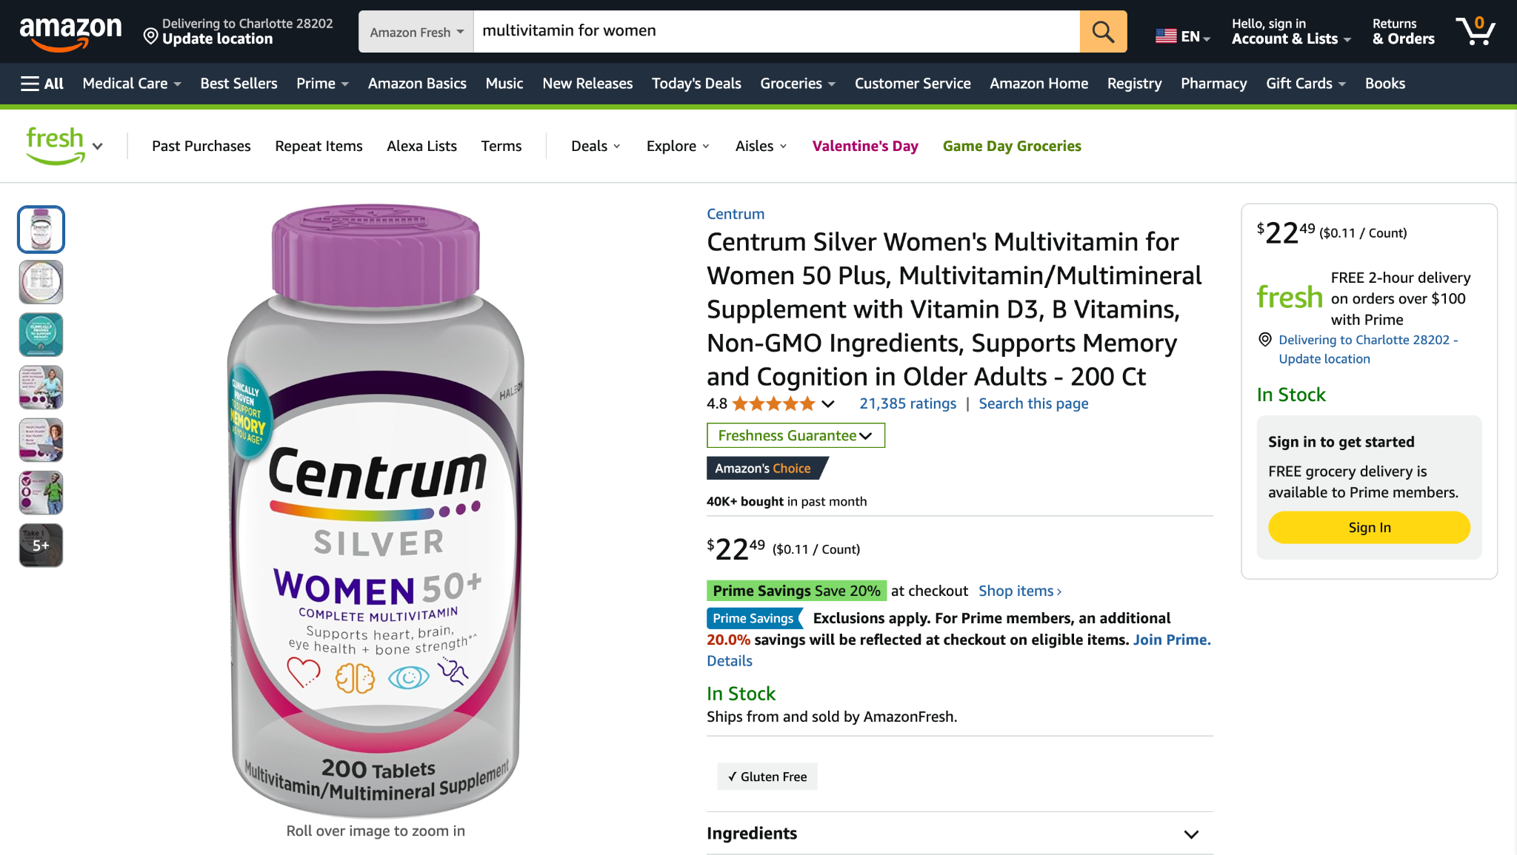
Product Page of Amazon is based on Inverted Pyramid Principle
This means that when you first see an Amazon product page, the most important details about the item, like its price, key features, and customer reviews, are immediately visible without needing to scroll down. This "above-the-fold" section is designed to quickly capture your attention and give you the essential information needed to decide if you want to learn more.

Slide 3
Color Choices
Dominant colors: Amazon uses a combination of blue, yellow, white, and black and green only with amazon fresh.
Call-to-action (CTA) buttons use high-contrast yellow for visibility.
Prices are typically in red or bold black to stand out along with prime saving highlights.
The color scheme follows Amazon’s brand identity but is sometimes overwhelming due to promotional banners.

Slide 4
Grid & Layout Structure
The page follows a two-column layout: product images on the left, details on the right.
Navigation is structured with clear sections (description, reviews, recommendations).
Some areas, like ‘Customers Also Bought,’ can feel cluttered.
Layout is effective for desktop but can feel compressed and long on mobile.

Slide 5
Typeface & Typography
Uses sans-serif fonts for readability.
Font hierarchy is clear: Large titles, bold prices, smaller product descriptions.
Too much bold text in promotional areas can create visual noise.
Readability is generally strong, but long product descriptions lack spacing.

Slide 6
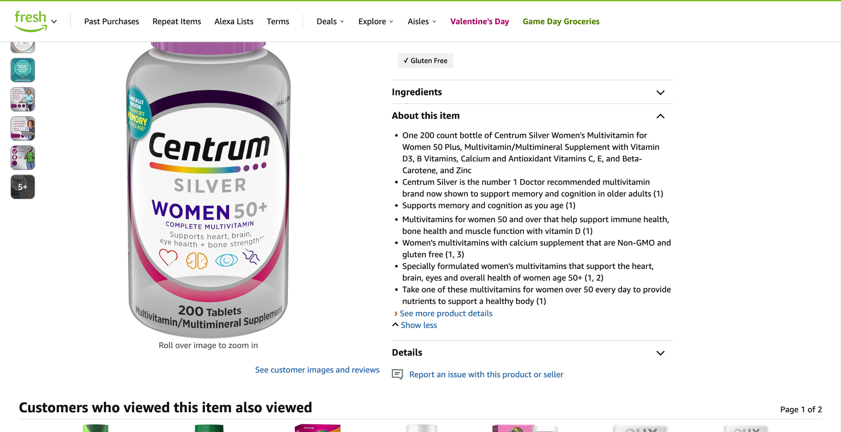
Use of Whitespace
Amazon’s page is information-dense with minimal whitespace.
Key product sections are spaced well, but additional promotions clutter the layout.
Some elements (e.g., bullet points in descriptions) lack adequate spacing for readability.
Improved spacing between related sections could enhance visual clarity.

Slide 7
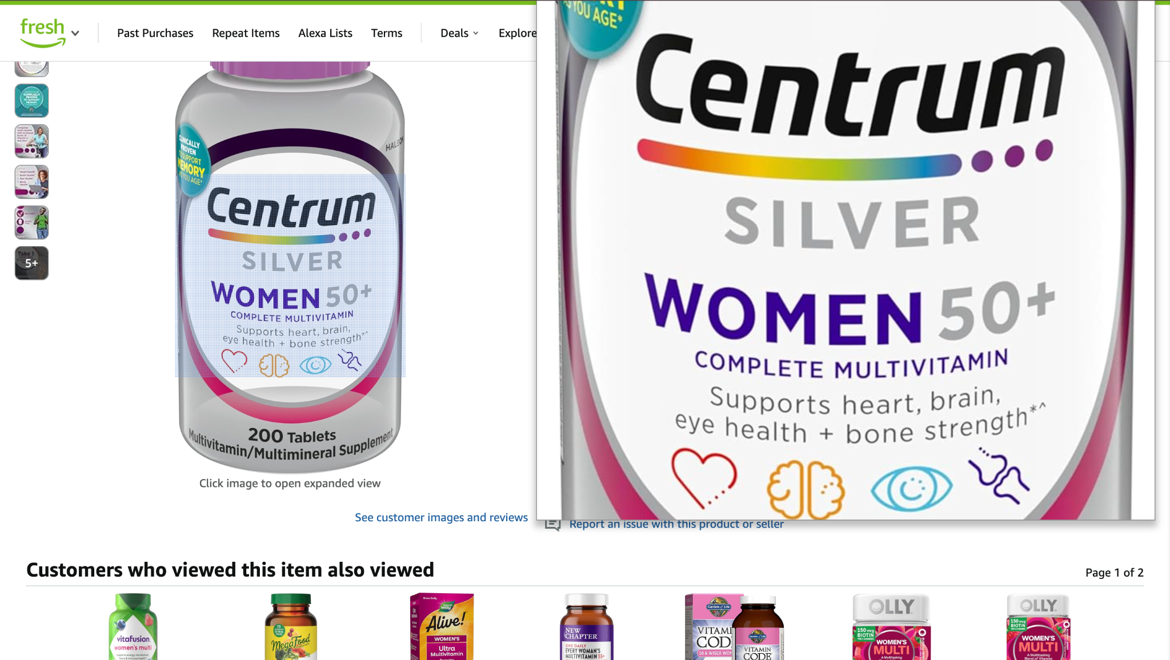
Images & Visuals
High-quality product images with zoom-in functionality.
360-degree views available for some products, enhancing the experience.
Additional visuals (videos, infographics) improve user engagement.
Some third-party seller images are lower quality, reducing professionalism.

Slide 8
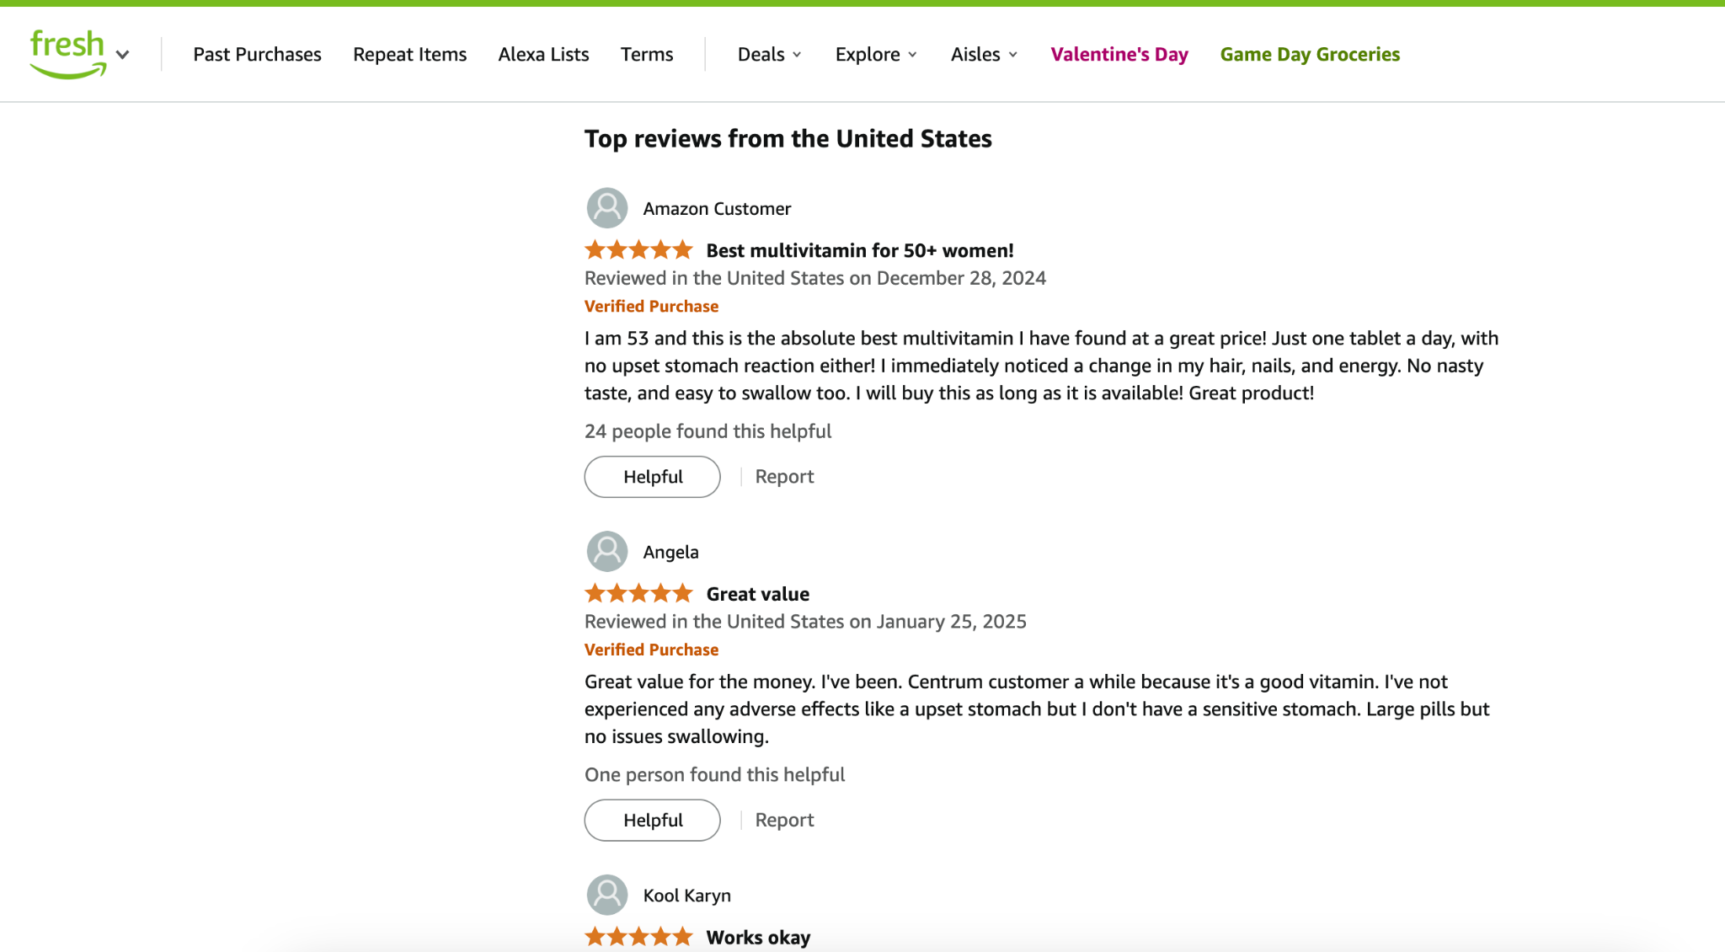
Other Notable Design Elements
Call-to-action buttons (e.g., ‘Add to Cart’) are well-positioned and clear.
Customer reviews section is visually engaging but contains too much text.
Promotional banners and pop-ups can feel intrusive.
Overall, the design is functional but could be more visually refined.

Slide 9
Summary & Recommendations
✔ Amazon’s product page effectively presents key product details.
✔ The layout, typography, and images provide clarity.
❌ Overuse of promotional content creates visual clutter.
❌ More whitespace and spacing improvements could enhance readability.
📌 Recommendations: Simplify promotional areas, improve spacing, and refine third-party images.

